Slide 1
Exception Handling

Slide 2
Version Control and Revision History
 | Name | Date
Prepared By | Paranthaman | 09-07-2019
Reviewed By | Team | 09-07-2019
Approved By | Team | 09-07-2019
Version No. | Date | Affected Sections | Highlights
2.0.0 |  | ALL | Updated Based on the course sheet coverage

Slide 3

Objectives
To learn and understand
Exception and exception class hierarchy
Handling Exceptions.
Try with resource statement (Java 7)
Multiple Exception Catching (Java 7)
Creating User-defined Exceptions
Using Assertions to detect logical errors
Notes:
It should be mentioned to the participant that current version of Java is 1.5, although not covered as part of this training.

Slide 4
Exception Handling
What is an Exception?
An exception is a problem that arises during the execution of a program. An exception can occur for many different reasons, including the following:
A user has entered invalid data.
A file that needs to be opened cannot be found.
A network connection has been lost in the middle of communications, or the JVM has run out of memory.
Some of these exceptions are caused by user error, others by programmer error, and others by physical resources that have failed in some manner.
Cause normal program flow to be disrupted

Slide 5
Exception Handling
Why Exception Handling?
Improves readability and maintainability
Error handling code is separated from the normal program
Adding more handlers requires more catch clauses without affecting the original program flow
Easy to say where the exception will be handled
Exceptions propagate the call stack at runtime
Caller can have its own error handling routines for some abnormal condition

Slide 6
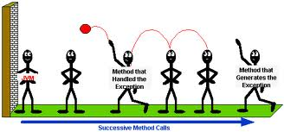
Exception Handling
Propagating an Exception
Before you can catch an exception, some code somewhere must throw one.
Any code can throw an exception: our code, code from a package written by someone else such as the packages that come with the Java platform, or the Java runtime environment. Regardless of what throws the exception, it’s always thrown with the throw statement.
Method that handled the exception
Method that generates the exception

Slide 7
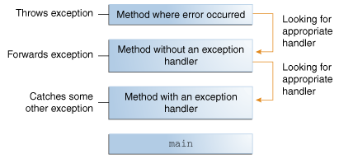
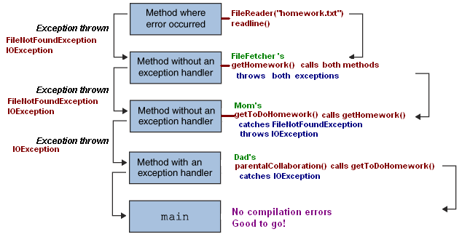
Default action When Exceptions occurs

Slide 8
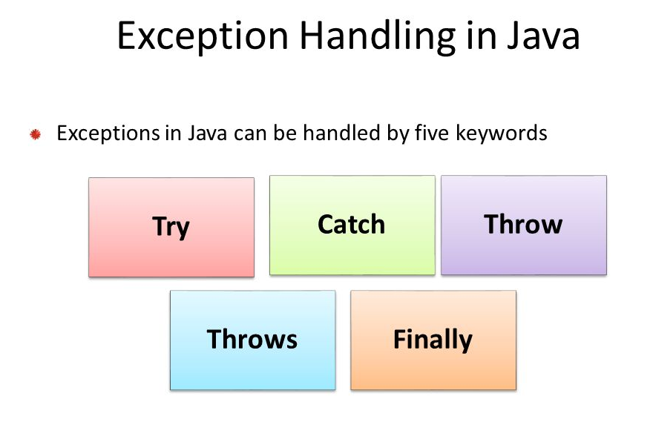
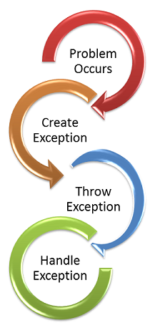
Handling Exceptions

Slide 9
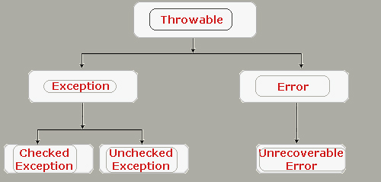
Exception Categories

Slide 10
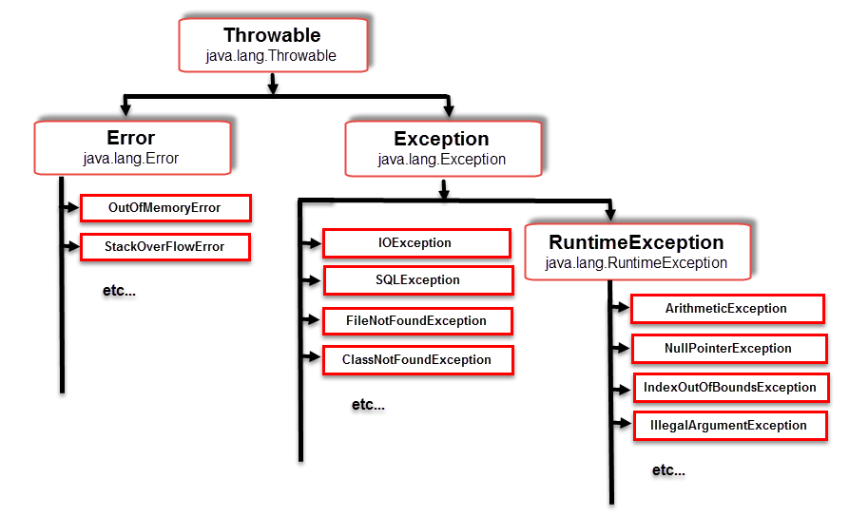
Exception Class Hierarchy

Slide 11
Exception Handling
Exception Class Hierarchy(Contd..)
The subclasses of java.lang.Exception are divided in two categories :
Checked Exception and
Unchecked Exception.
Checked Exceptions:
Classes that extend Throwable class except RuntimeException and Error are Checked Exceptions. They are checked at compile-time by the Java compiler.
Compiler checks each method call and method declaration determines whether method throws checked exceptions.
If so, the compiler ensures checked exception caught or declared in throws clause.
If not caught or declared, compiler error occurs.
Examples:
ClassNotFoundException
IOException
FileNotFoundException

Slide 12
Exception Handling
Exception Class Hierarchy(Contd..)
Unchecked Exception:
The classes that extend RuntimeException are known as Unchecked Exceptions.
Unchecked exceptions are those exception objects which don't have to be explicitly caught. Whenever an unchecked exception occurs JVM will handle it automatically.
Compiler does not check code to see if exception caught or declared rather they are checked at run-time.
Examples:
NullPointerException
IndexOutOfBoundsException
ArrayIndexOutOfBoundsException

Slide 13
Exception Handling
Exception Class Hierarchy(Contd..)
Error class
Used by the Java run-time system to handle errors
occurring in the run-time environment
Generally beyond the control of user programs
This type of abnormal conditions are errors which can comes from external sources or agent.
The instances which are type of java.lang.Error cannot be recovered in java program. They have to be correct by external source.
Examples
OutofMemoryError
AssertionError
VirtualMachineError

Slide 14
Exception Handling
Exception Handling in java is done using try, catch, throw, throws, finally clause
try {
// statement that could throw an exception
}catch (<exception type> e) {
// statements that handle the exception
}catch (<exception type> e) { //e higher in hierarchy
// statements that handle the exception
}finally {
// release resources
}
//other statements
At most one catch block executes
finally block always executes once, whether there’s an error or not

Slide 15
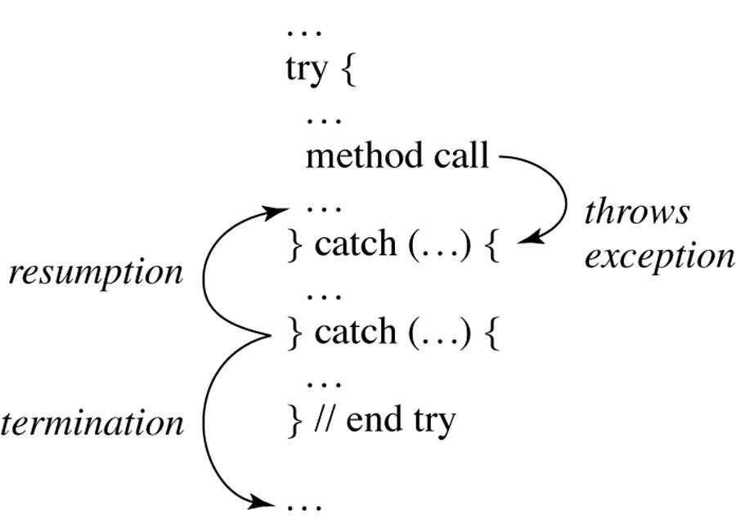
Exception Handling
Multiple Catch
It is possible that a statement might throw more than one kind of exception
We can list a sequence of catch blocks, one for each possible exception
There is an object hierarchy for exceptions - since the first one that matches is used and the others skipped, put a derived class first and its base class later or else it will result in a compiler error.

Slide 16
Exception Handling
Finally Clause
A finally block encloses code that is always executed at some point after the try block, whether an exception was thrown or not.
Even if there is a return statement in the try block, the finally block executes right after the return statement is encountered, and before the return executes
Will not execute if the application exits early from a try block via method System.exit()

Slide 17
Exception Handling
Propagating an Exception
Throw Clause:
You can throw an exception, either a newly instantiated one or an exception that you just caught, by using the throw keyword.
The throw statement requires a single argument: a throwable object.
Throwable objects are instances of any subclass of the Throwable class.

Slide 18
Exception Handling
If method is capable of throwing an exception or If a method does not handle a checked exception, then calling programs needs to be informed about it. This is done by throws
Throws Clause:
The throws keyword appears at the end of a method's signature followed by a comma separated list of Exceptions.
Throws clause is not commonly used for Exceptions of type Error, RuntimeException, or its subclasses

Slide 19
Exception Handling
User-Defined Exception
You can create your own exceptions in Java. For creating user-defined exceptions we must ensure that:
All exceptions must be a child of Throwable.
If you want to write a checked exception we need to extend the Exception class.
If you want to write a runtime exception, you need to extend the RuntimeException class.

Slide 20
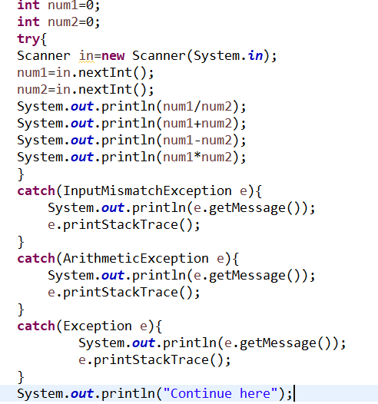
Try with Catch

Slide 21
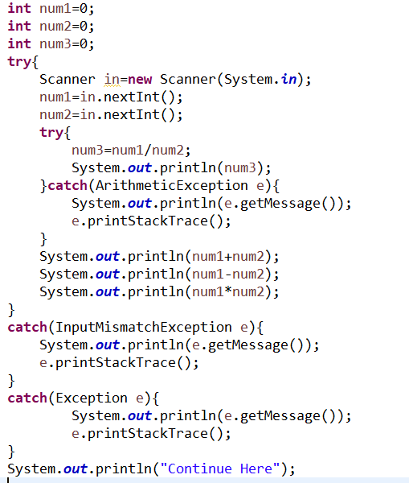
Nested Try Block

Slide 22
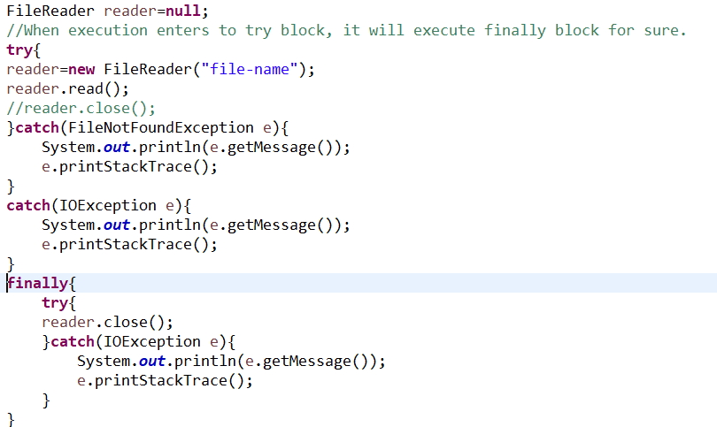
Finally Block

Slide 23
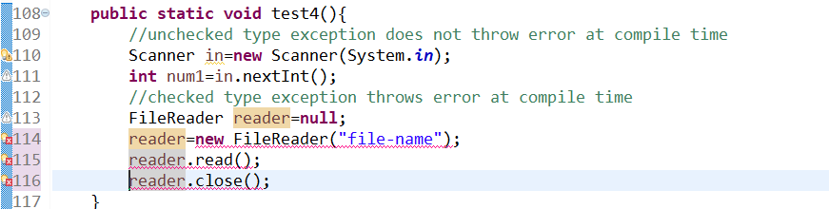
Checked vs Un Checked

Slide 24
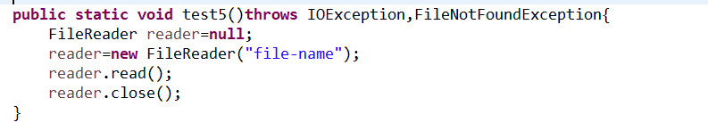
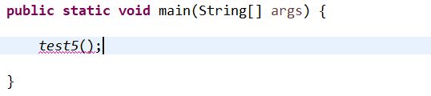
Throws

Slide 25
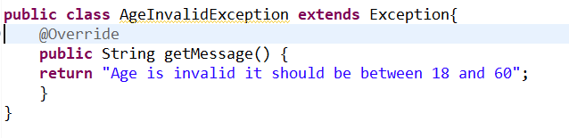
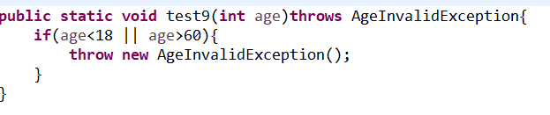
Throw & User defined Exception

Slide 26
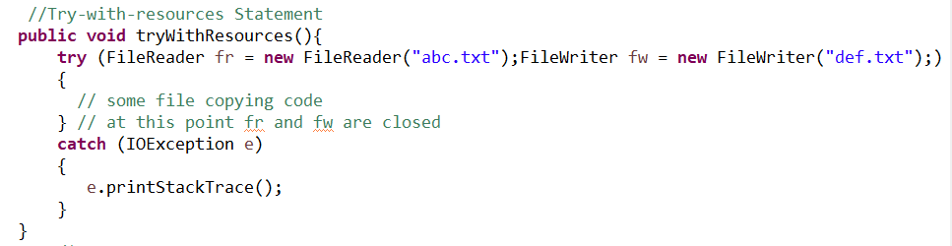
Try with resource statement (Java 7)
It is also known as Automatic Resource Management(ARM).
The try with resource statement contains declaration of one or more resources.
Prior to Java SE 7 resource object must be closed explicitly, when the resource use or work is finished.
After the release of Java SE 7 the try with resource statement handles it implicitly means it automatically closed the resource when it has no longer use to the class.
Example code is given the next slide.

Slide 27
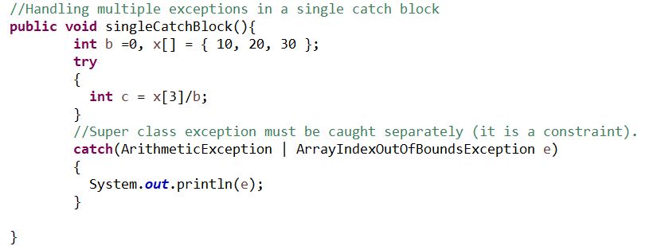
Multiple Exception Catching (Java 7)
Java 7 introduced multi-catch functionality to catch multiple exception types using a single catch block.
In the pre Java 7 world, you would handle exceptions by writing separate catch blocks for different types of exceptions that occur in the try block.
Java 7 multi catch block provides you the flexibility to combine such catch blocks provided you have similar code to handle these exceptions.
Example code is given the next slide.

Slide 28
Assertions
An assertion is a Java statement in the program specifying whether the current state of the computation is as expected
Assertions can be used to assure program correctness and avoid logic errors.
Must form a boolean expression that
When evaluated to true nothing happens
The program state is ok
When evaluated to false throws AssertionError
Can be disabled during runtime without program modification or recompilation
Two forms
assert condition;
assert condition: expression;

Slide 29
Assertions
Example:
public class AssertionDemo {
public static void main(String[] args) {
int i; int sum = 0;
for (i = 0; i < 10; i++) {
sum += i;
}
assert i == 10;
assert sum > 10 && sum < 5 * 10 : "sum is " + sum;
}
}

Slide 30
Assertions
By default, the assertions are disabled at runtime. To enable it, use the switch –enableassertions, or –ea for short, as follows:
java –ea AssertionDemo
Assertions can be selectively enabled or disabled at class level or package level. The disable switch is –disableassertions or –da for short.
Example: The following command enables assertions in package package1 and disables assertions in class Class1.
java –ea:package1 –da:Class1 AssertionDemo

Slide 31
Assertions
Exception Handling Vs Assertions
Assertion should not be used to replace exception handling. Exception handling deals with unusual circumstances during program execution. Assertions are to assure the correctness of the program.
Exception handling addresses robustness and assertion addresses correctness.
Like exception handling, assertions are not used for normal tests, but for internal consistency and validity checks.
Assertions are checked at runtime and can be turned on or off at startup time.

